Slide 1
Mario Kart 64 Analytics
The Karty Boyz:
(Troopa Style)
Michael Abed
Jonathan Bell
Johan Mickos
Josh Navon
Mark O’Brien

Slide 2
Objectives
Develop an analytics engine and database for Mario Kart 64, starting off with a focus on Koopa Troopa Beach
Capture and store important events in the database
Capture exciting moments during Mario Kart races
Allow users to ask questions about collected events in a user-friendly manner.

Slide 3



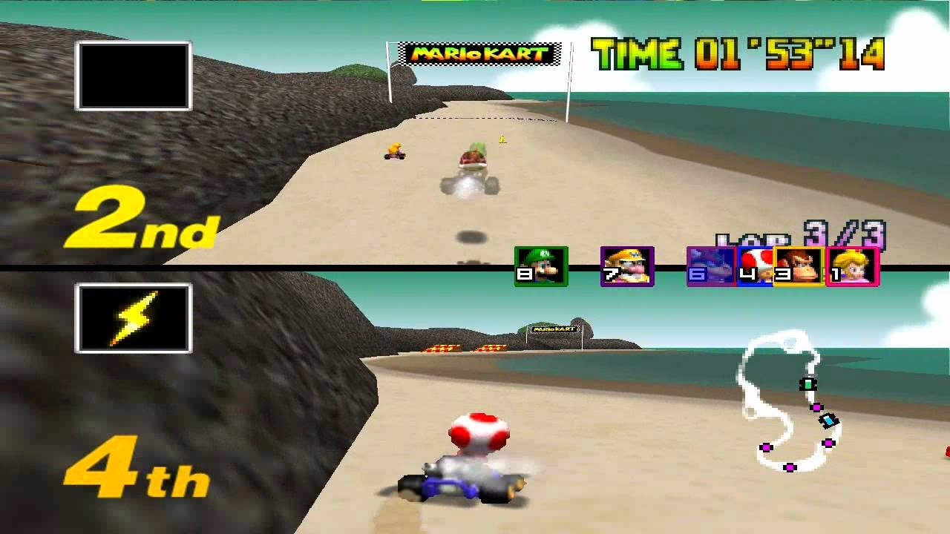

Visualization
Computation
Video Capture
Database
Queries
Check out my stats!

Slide 4
Deliverables
An expanded Mario Kart 64 experience.
Computational engine for Mario Kart 64 analytics.
Database to store race statistics (persistent).
Interface to query the database
Cloud-based video streaming/storage
Microphone

Slide 5
Requirements
Event detection
  Properly detect and tag at least 90% of all events
  Improperly detect and tag at most 5% of events
Must Recognize These Types of Events
  Changing places
  Game begin/end
  Lap changes
  Collisions
  Getting Item
  Shortcut detection (course specific)
  Boost detection (starting boost, mushroom, and drifting)

Slide 6
Requirements (cont.)
Exciting Moment Tagging
  Speech recognition for “TAG IT”
    Must have false negative rate less than 3%
    False positive rate less than 15%
  Tag durations where volume is over some (TBD) threshold
Database (DB)
  Race events are stored in a table
  Statistics can be queried in an easy (non-SQL) manner
    Can answer “What was Yoshi’s average lap time on Koopa Beach?”
Cloud Server
  Processes a race in less than 2x the race duration
  Can separate a video of many races into individual race videos
  Users can upload race videos for processing

Slide 7
Competing Technologies / Patents / Other Products
Kartlytics (Joyent)
  Demo for a database product

Slide 8
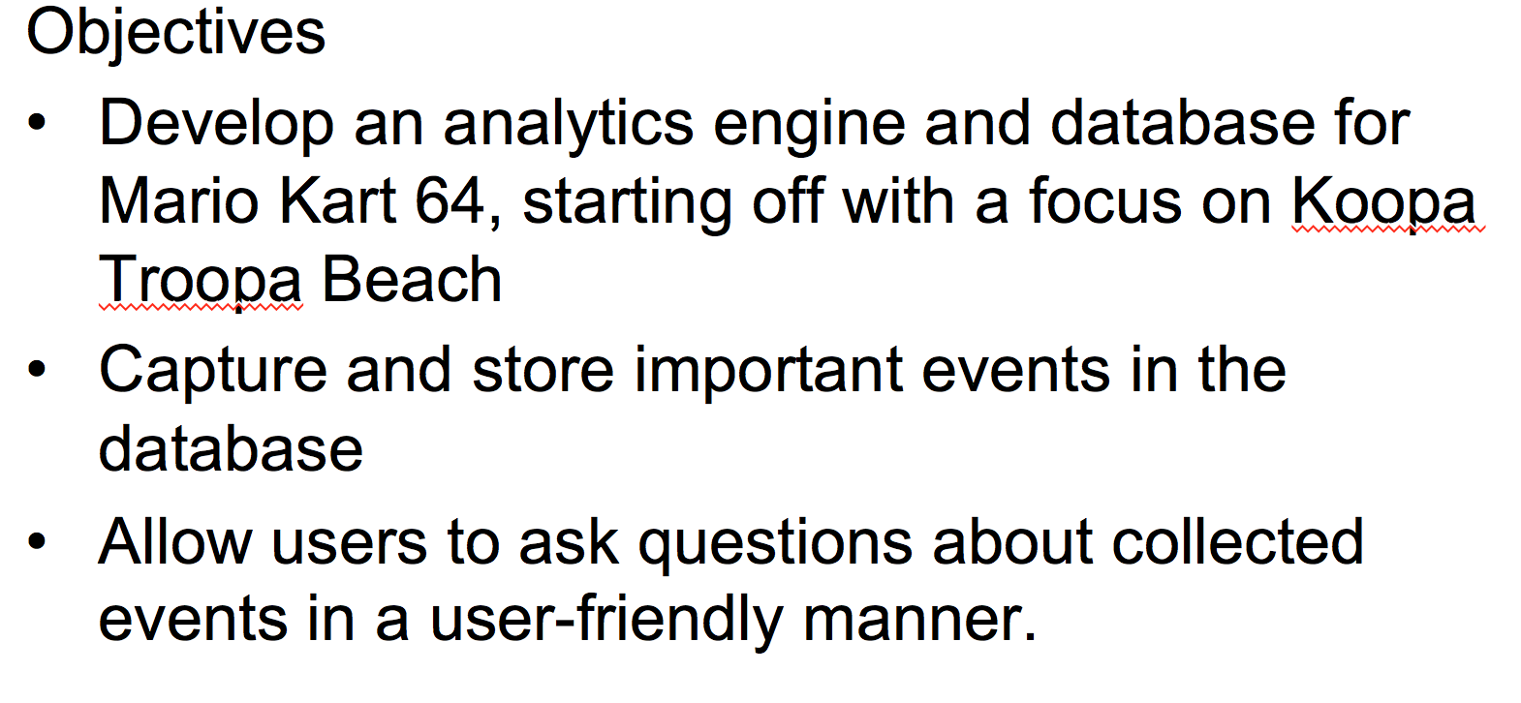
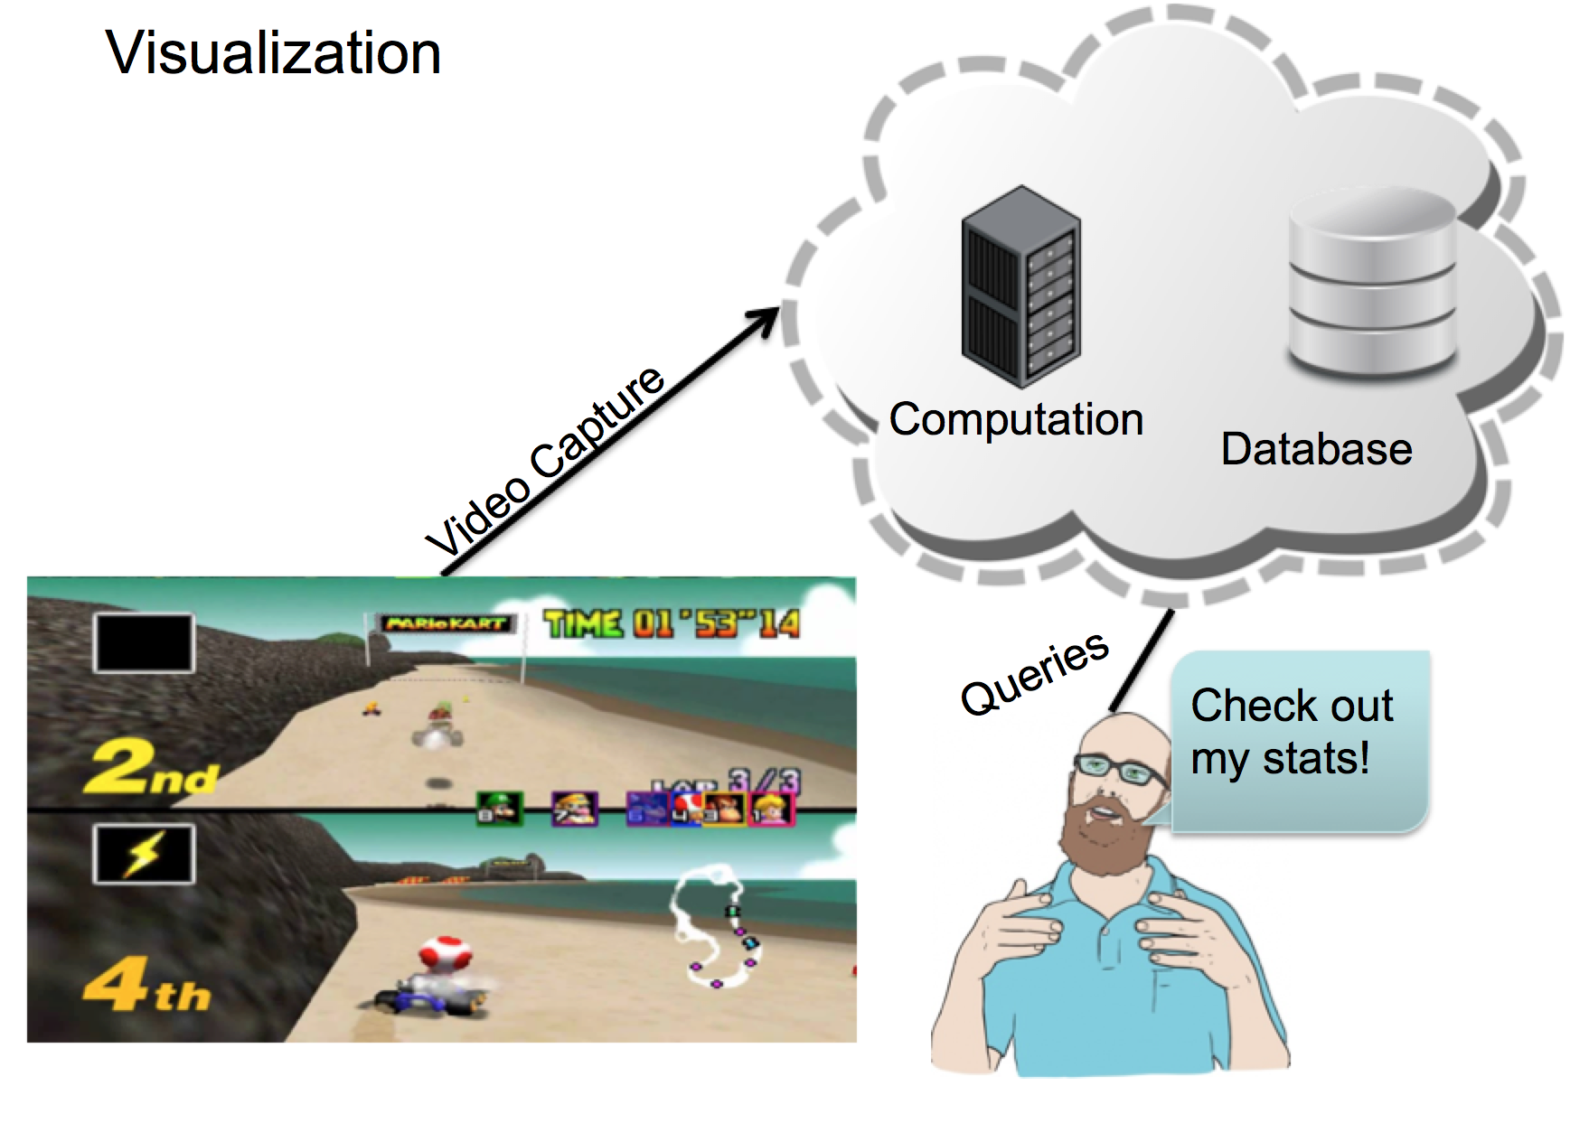
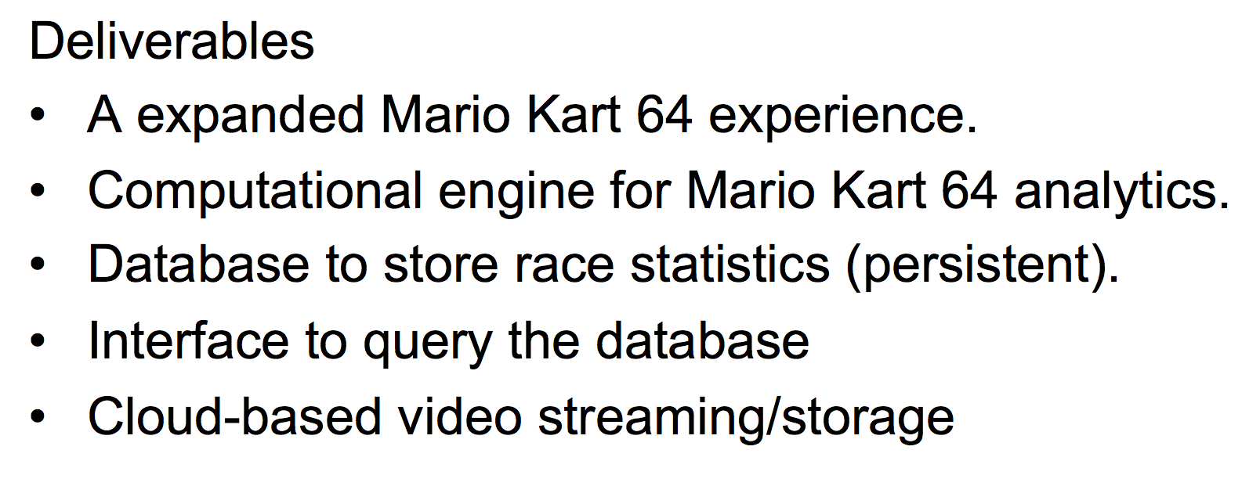
Technical Approach
Schedule
Wait until Concept Review
Wait until Concept Review
Budget / Resources

